Slide 1
TUTORIAL
1.Write the place and manner of articulation of the following phoneme
/k/, /g/,/u/,/g^{h}/, /ɽ/, /ʃ/
2. Write out the phonetic transcription for the following words:
/she/, /phonetic/, /marks/, /speech/,
How many syllable is present in each of the above word.
3. Draw Schematic representation of the physiological mechanism of speech production system and explain how the a voiced sound is produce.
4. A voiced operated lift operation is designee using the following words
a. stop, b. up, c. down d. floor e. first f. second g. third h. fourth and i. ground.
Figure 1 shows wideband spectrograms of one version of each of these words. Using your knowledge of acoustic phonetics, determine which wideband spectrogram corresponds to which word.
5. The following waveform is for the utterance /kolkata/ and the waveform samples are at a sampling rate of FS =22050 Hz. Segment the waveform into regions of "Voiced Speech (V)" and "Non-Voiced Speech (N)".
6. Which formant frequency is related to tongue height and which formant related to tougue position
7. Why the child speech has high F0 and formant compare to a adult
ET60007 © CET, IITKGP

Slide 2
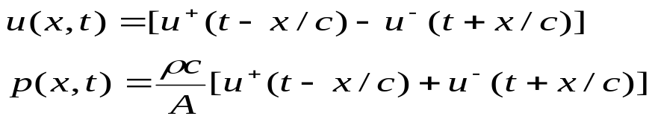
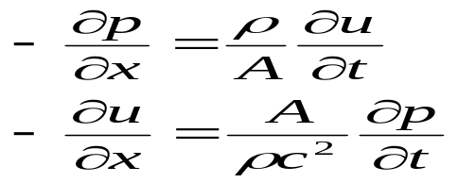
TUTORIAL
1. By substitution, show that the set of equation:
Are solutions to the partial differential equations:
2. What are the Assumption consider to derive the wave equation
3. Derive the transfer function of a single tube model considering the boundary condition.

Slide 3
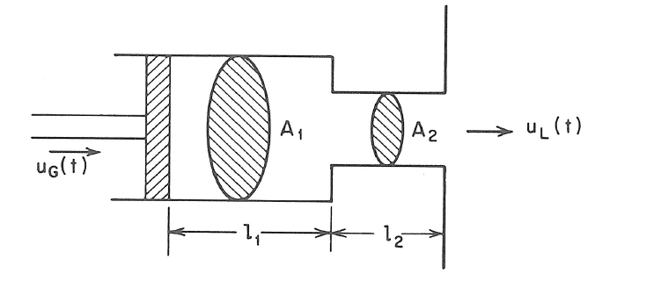



Consider an ideal lossless tube model for the production of vowels consisting of 2 sections as shown in the figure below. Assume that the terminations at the glottis and lips are completely lossless.
For the above conditions the system function of the lossless tube model is obtained from the following equation:
(a) Show that the poles of the system are on the jΩ axis and are located at values of satisfying the equations:

Slide 4
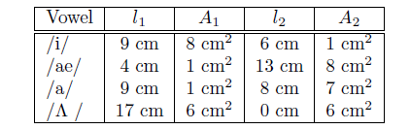
(b) The values of that satisfy the equations derived in (1) are the formant frequencies of the lossless tube model. By judicious choice of the parameters l1, l2, A1, and A2 we can approximate the vocal tract configurations of vowels, and by solving the above equations obtain the formant frequencies for the model. The following table gives parameters for several vowel configurations. Solve for the formant frequencies for each case. (Note that the nonlinear equations must be solved graphically or iteratively.) Use c = 35000 cm/sec.

Slide 5
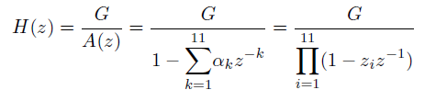
1. Linear prediction analysis is used to obtain an 12-order all-pole model for a segment of voiced speech that was sampled at a rate of FS = 10000 Hz. The system function of the model is:
Table 1 shows 6 roots of the 12-order prediction error filter, A(z).
sl | Root magnitude | Root angle
1 | 0.938 | -10.36
2 | 0.9317 | 25.88
3 | 0.7837 | 35.13
4 | 0.9109 | -82.58
5 | 0.5579 | 91.44
6 | 0.9571 | -104.29
Determine where the other six pole of A(z) are located in the z-plane. Plot the pole location in z plane
Determine the first four formant and formant bandwidth

Slide 6

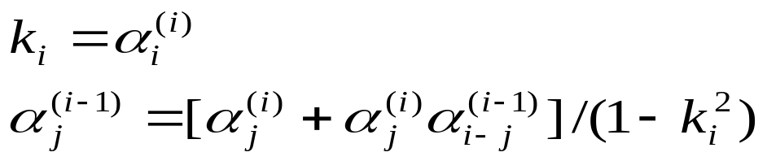
2. A causal LTI system has system function:
Use the Levinson recursion to determine whether or not the system is stable.
(b) Is the system minimum phase?
where

Slide 7
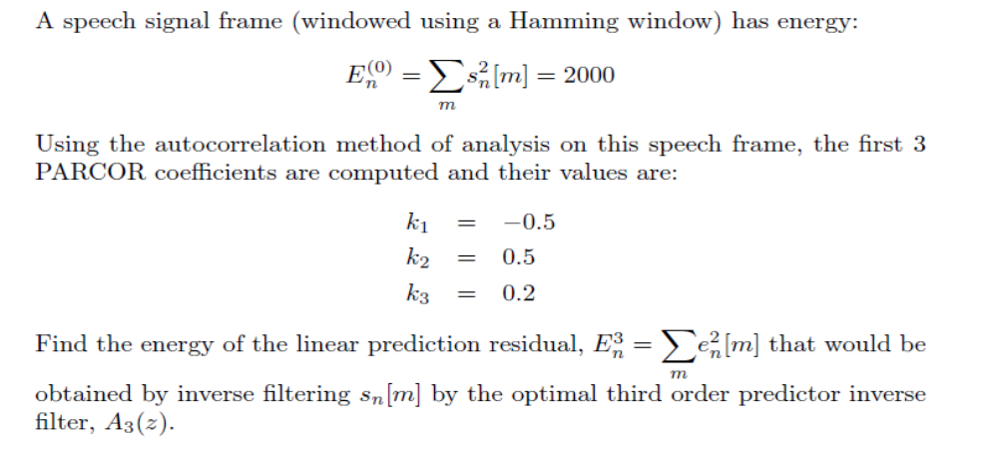
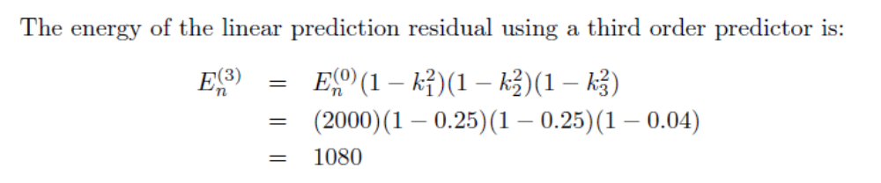
solution

Slide 8
A sinusoid of 4kHz sampled with 10 kHz sampling frequency. How many time the signal will be cross the zero line of 40ms segment.
What are the time domain methods for extraction of F0
How F0 is extracted using autocorrelation method
What are the perceptual parameters of speech?
Suppose an electric fan produces an intensity of 40 dB. How many times more intense is the sound of a conversation if it produces an intensity of 60 dB?
What do you mean by 0dB?
Which of the following pair of tones is perceived as louder tone?
20dB level at 1kHz and 20 db at 500 Hz
5dB level at 3 KHz and 5dB level at 2 KHz
8. What will be the perceive pitch (in Mels) for the following tone
a) 100 Hz, b) 120 Hz, c) 500 hz
F(mels)=3323log₁₀(1+f/1000)

Slide 9
What is segmental and supra-segmental features of speech signal
Draw the block diagram of CC parameter extraction.
Draw the block diagram of PLP parameter extraction.
What are the different technique for speech synthesis
What are the Supra-segmental Features of Speech control the speech prosody
What is speech prosody

